Slide 1





INTERNSHIP AT ALTEN SO
R&D : Urgency in the Digital Twin Smart Green Supply Chain
Adding a fourth score to the twin: the distance between declared and real urgency
HOARAU John
Cohort 2026 DED
COMPANY
PERIOD
TUTORS
ALTEN Sud-Ouest
13 April → 16 October 2026
S. Perthuisot and F. Jules, ALTEN
Innovation Division · Toulouse Lab
Confidential: YES
Dr. D. Gomez, ESTIA · Dr. P. Sherar, Cranfield
Figures are original work unless indicated. ALTEN material used with permission.
Notes:
(Name, Intership, ALTEN SO, DIN , TLSE)
1 number to open
8 turns before a satellite manufacturer missed its delivery commitment, the tool I built had already flagged it.
At that moment, its own manager was declaring an urgency near inexistent
Flagging, mesuring, forecasting that gap is what this mission is realy about

Slide 2







PLAN
1
CONTEXT, PROBLEM, MISSION
2
HOW THE PROJECT WAS RUN
3
LITERATURE, DESIGN AND REALISATION
4
RESULTS AND VALIDATION
5
ASSESSMENT AND PERSPECTIVES
2
Notes:
This prez will be in 5 parts !
The first three build the instrument.
The 4 is where the number I just gave you comes from.
The 5 is what I would do next.

Slide 3




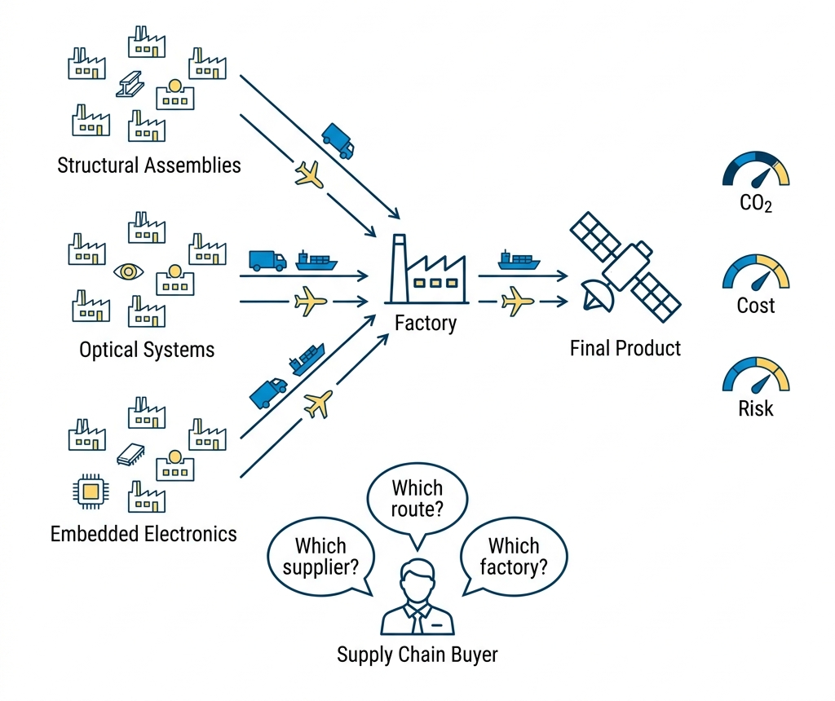




THE COMPANY AND THE PROGRAMME
1
2
3
4
5
ALTEN · Innovation Division · Toulouse Lab
3
1988
+30
11
31 %
FOUNDED
COUNTRIES
ALTEN LABS
R&D ON ENVIRONMENT
THREE SCORES EXIST IN THE TWIN. THE FOURTH DOES NOT.
1
LEAN · COST SCORE
Cost, delay, excess stock
2
GREEN · CO2 SCORE
Carbon per transport leg, to GLEC v3.2 and ISO 14083
3
PREDICTIVE · RISK SCORE
Probability that a node disrupts
4
URGENCY · NO SCORE AT ALL
Declared by a human every week, and never checked against anything.
My mission is that fourth score.
DISCO: the DIN's serious game and digital twin, 22 suppliers
Notes:
ALTEN Eng/Tech Consulting group.
Sell Eng expertise rather than product
Consulting grp work for many clients, they see the redudency in the diffuculty companys are facing
That how problem gets recognised as belonging to the industry rather than to a customer.
The program SGSC aim to unite Lean,Green,Predictive in a DT. My work sit in the 3rd one
Its central artefact is DISCO, a serious game and digital twin covering twenty-two suppliers.
Earlier internships built the routing, the risk scoring, the carbon and the transport
Not one of them computes urgency.

Slide 4





THE PROBLEM
1
2
3
4
5
4
WHAT A SUPPLY CHAIN COORDINATOR IS ASKED TO MANAGE
YESTERDAY
TODAY
TOMORROW
Projects and actions
A queue of urgencies
The urgency that is real
A plan, and progress against it.
Everything on the list is urgent.
Which one deserves the attention.
THE TWIN HAS
THE TWIN NEVER SEES
Computed physical state
The human who decides
RESEARCH QUESTION
Can the gap between declared and computed urgency be measured reliably enough, inside a working digital twin, to be acted upon?
It must say which node is mismanaged
It must be reliable and explainable
It must beat the raw indicators a coordinator already has
Notes:
A coordinator opens the week with a list of nodes and a finite amount of attention
Somewhere on that list is the supplier that will cause next month's line stoppage. Nothing on the screen says which one it is. Thats what we try to figure out and avoid, -> where we should put more time to avoid catastrophic events.
The twin computes the physical state of every node. What it never sees is the human who decides.
A buyer says a supplier is critical, a plant says a line is at risk, and the twin records the consequence of those judgments without ever evaluating them.
Littérature showed across five controlled experiments that people favour imminent low-value tasks over distant high-value ones, and that the bias survives being told about it.
A twin that swallows that declaration as ground truth inherits the bias.

Slide 5
THE MISSION AND ITS OBJECTIVES
1
2
3
4
5
Build the fourth score: elicit an urgency, compute its counterpart, measure the distance
5
THE MISSION, IN THREE MOVES
1
ELICIT
2
COMPUTE
3
COMPARE
Ask the operator to declare an urgency on a node, and refuse an incoherent answer.
Read the same node's urgency from its operational state, with no human in the path.
Score the distance between the two, propagate it, and explain it term by term.
AND THE FIVE OBJECTIVES IT WAS BROKEN INTO
OBJECTIVE
INDICATOR
O1
Define real/declared urgency and the adequacy score
Every term decomposable, aggregation justified
O2
Propagate across tiers, rank by criticality
Real-programme scale, interactive time budget
O3
Deliver a working, auditable application
Every write logged, tests passing
O4
Establish whether the signal predicts outcomes
Tested in the serious game, against a baseline
O5
Estimate warehouse capacity from satellite imagery
Segmentation quality, calibrated volume
Notes:
5 objectives
I flag the fourth now, because it changed the shape of the mission.
Its test runs inside the serious game, against a baseline
Holding to that clause turned a validation step into the main contribution.

Slide 6
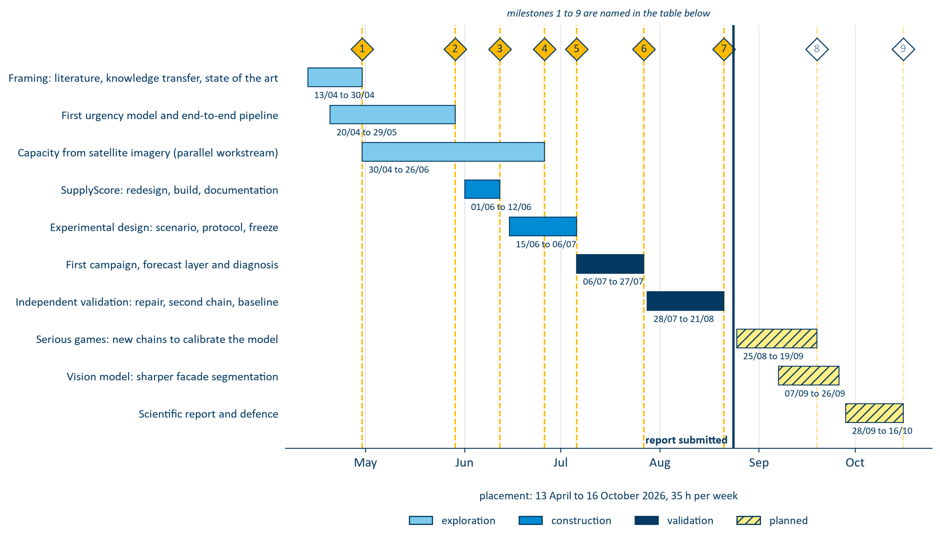
HOW THE WORK RAN
1
2
3
4
5
One situation, two signals elicited independently, and four loops of measurement
6
THE INSTRUMENT
1
2
DECLARED Ud
4
5
A SITUATION
A human answers the questionnaire. AHP, four criteria.
THE ADEQUACY A
WHAT THE OPERATOR SEES
A frozen supply chain: nodes, arcs, milestones, and the events of one week.
The distance between them, on 0 to 100. Over-declared is false urgency, under-declared is hidden risk.
A ranked list of nodes, and one page that rebuilds any score term by term.
3
COMPUTED Ur
The twin reads six KPI blocks. No human in the path.
FOUR LOOPS, AND WHAT EACH ONE CHANGED
LOOP 0
LOOP 1
LOOP 2
LOOP 3
LOOP 4
Synthetic dry run
Eight blind agents
Forecast shown
A second chain
Closed loop
Declaration anchored on the computed value. Not usable.
Built the interface and the agent harness. 152 declarations.
One change only: the model's output reaches the declarant.
15 nodes, no external shock. The boundary of the claim.
Declarants act on the terrain, after the repair.
Loop 0 did not convince me: the two signals were not independent. That is why the interface and the agents exist at all.
AND THEN TWO QUESTIONS, IN THIS ORDER
6
7
DOES IT SEE WHAT ACTUALLY HAPPENED?
CAN IT FORECAST WHAT HAS NOT HAPPENED YET?
Replay the 2020 to 2022 semiconductor shortage, a crisis whose outcome is known, and check what the score flagged before it became public.
Attach a probability to a named week, 500 Monte-Carlo trajectories, and score it against a baseline that uses no model at all.

Slide 7
PLAN
1
CONTEXT, PROBLEM, MISSION
2
HOW THE PROJECT WAS RUN
3
LITERATURE, DESIGN AND REALISATION
4
RESULTS AND VALIDATION
5
ASSESSMENT AND PERSPECTIVES
7
Notes:
This prez will be in 5 parts !
The first three build the instrument.
The 4 is where the number I just gave you comes from.
The 5 is what I would do next.

Slide 8




THE WEEK
1
2
3
4
5
V-cycle on the model · a one-week Agile loop on the team
8
MON
TUE
WED
THU
FRI
Planning
Scrum
Programme director
Scrum
Demonstration
The week’s objective
Blockages surface in a day
Taken in place of the scrum
Course correction
Shown
Blue: the team's own rhythm. Ochre: someone outside the team judges the week.
Why one week: new consultants join the Toulouse Lab every Monday afternoon, so the team that opens a sprint is rarely the team that closes it.
TEST AND LEARN COUNTS ONLY IF SOMETHING WAS DROPPED
WHO I ANSWERED TO
Innovation Division (DIN)
The first urgency model, and why it could not fit
the internal R&D operation
A single time-driven curve: urgency rose only as a deadline approached
Smart & Green Supply Chain
the programme, 2 company tutors
It could not represent a node on time but out of capacity
SupplyScore
the project, mine to run
It discarded indicators the twin already held
8 declarants per campaign
the people the tool asks
Dropped in April, at a cost of three weeks. It was R&D, and the loop is what caught it.
Notes:
The internship agreement prescribes Agile and Test and Learn, and I applied it literally.
The V-cycle runs on the model. Agile and Test and Learn run the week.
Five standing meetings a week is heavy for research and development, and it was the most useful organisational feature of the internship.
The Friday demonstration required something to be shown, making sure that project is evolving.
Test and Learn means something only if things were dropped and that i devlopped knowledge
The first urgency model was a single time-driven curve that rose as a deadline approached. It could not represent a node on schedule but out of capacity
I dropped it in April, at a cost of three weeks.
I gain knowledge and expericen in suplly chain organization, digital twin modeling and AI as i experienced all of them.

Slide 9
PHASES AND MILESTONES
1
2
3
4
5
10 phases · 9 milestones · one week inside each of them
9
THE CALL
The plan gave the second half to extending the model.
I moved it to validating what already existed.
An unvalidated extension of an unvalidated model compounds the problem.
Notes:
Ten phases, nine milestones, seven closed at the time of writing
One decision matters more than the rest. The original plan gave the second half of the mission to extending the model's scope. I reallocated it to validating what already existed.
An unvalidated extension of an unvalidated model compounds the problem rather than advancing it. That is why I can state a measured result today
Everything to the right of that line is planned, not done.

Slide 10
PLAN
1
CONTEXT, PROBLEM, MISSION
2
HOW THE PROJECT WAS RUN
3
LITERATURE, DESIGN AND REALISATION
4
RESULTS AND VALIDATION
5
ASSESSMENT AND PERSPECTIVES
10
Notes:
This prez will be in 5 parts !
The first three build the instrument.
The 4 is where the number I just gave you comes from.
The 5 is what I would do next.

Slide 11






LITERATURE: WHAT NOBODY JOINS UP
1
2
3
4
5
Six streams, three patents, and one empty box
11
PUBLISHED RESEARCH
THE PATENT RECORD: THREE LINES
Deadline-driven value. Time-varying, but one task only.
IBM. Revenue at risk from measured inputs. No operator opinion anywhere in the claims.
Ripple effect. Propagates, but takes the node score as given.
Wipro. Inputs replaced by language. The human narrates; nothing evaluates the narration.
Rupture indicators. Monitored one at a time, never combined.
Digital twin control tower. Oriented to automation. The operator receives decisions.
Cognitive bias. Quantified in the lab, no operational correction.
AHP, BWM, PROMETHEE. Static, and never compared to a computed value.
Fifteen years spent removing the human declarant.
AND THE FIELD IS TURNING BACK
Digital twins. Scored on state; their inputs are assumed to arrive.
Industry 5.0 puts the human at the centre again (European Commission, 2021). Tesla called over-automation at Fremont a mistake in its own 2018 update letter.
THE GAP
No system, published or patented, elicits a declared urgency, computes its counterpart on the same node, and scores the difference against what happened.
Notes:
I looked in two places.
Six streams, and each one settles something and leaves something open.
Read the second half of each line and you have my specification.
The patent record was more interesting.
IBM, 2007: computed entirely from measured inputs.
Wipro, 2019: those inputs are replaced by language, so the human narrates but is never assessed.
The most recent is a control tower where the operator receives decisions.
Fifteen years running away from the human declarant.
So the gap is specific. No system, published or patented, elicits a declared urgency, computes its counterpart on the same node, and scores the difference against recorded outcomes

Slide 12

THE URGENCY SCORE, TERM BY TERM
1
2
3
4
5
Two signals elicited separately, and a deliberately asymmetric distance
12
DECLARED U_{D}
COMPUTED U_{R}
AHP · FOUR CRITERIA · CONSISTENCY GATE
SIX KPI BLOCKS · PROBABILISTIC OR
Operational impact
↔
Performance and capacity
Time window
↔
Time, against the next deadline
Downstream dependencies
↔
Severity propagated across tiers
Recoverability
↔
Risk, through its recovery term
No declared counterpart
↔
Cost and carbon, arbitration only
ADEQUACY SCORE
The distance between the two signals, on a 0 to 100 scale.
False urgency · declared above computed · weight 1.0
Weight 2.25 is Prospect Theory's loss aversion.
Under-triage costs a life where over-triage costs a queue.
Hidden risk · computed above declared · weight 2.25
Notes:
LEFT , declared urgency: Each node the operator compares 4 criteria pairwise, which yields to a consistency-checked method for each criterion
On the RIGHT, computed urgency, from 6 indicator blocks.
They all have contrepart so they can be compared together
Just Cost and C02 haven’t as they are arbitrate.
The 1st part of the internship has to make this to get the Adequacy score wich is the distance between the types of urgency, on a 0-100 scale, and it is made delibertely asymmetric.
False urgency costs one. Hidden risk costs twice as much.
That is the rule clinical triage has applied for decades: under-triage costs a life where over-triage costs a queue. We mimic this here.

Slide 13



REAL URGENCY
1
2
3
4
5
Non-compensatory aggregation: one failed block cannot be masked
13
A node is in trouble if any one block fires. A healthy block cannot offset a failed one.
U_{r} = 1 − ∏_{m} (1 − u_{m})^{ω}_{m}
NODE A
NODE B
one block has failed
nothing has failed
The average sends the coordinator to Node B , where nothing broke. The OR sends them to Node A , where capacity did. Same six numbers, opposite ranking.
time
0.05
time
0.20
capacity
0.90
capacity
0.20
performance
0.05
performance
0.20
risk
0.05
risk
0.20
SIX BLOCKS: FOUR CAUSES, TWO CONSTRAINTS
cost
0.05
cost
0.20
carbon
0.05
carbon
0.20
Time
Capacity
Performance
average
0.19 → 2nd
average
0.20 → 1st
probabilistic OR
0.92 → 1st
probabilistic OR
0.74 → 2nd
Risk
Cost
Carbon
The same six blocks and the same weights also drive PROMETHEE II, which ranks the nodes against each other.
Notes:
A moment on the aggregation method, because it is the central modelling decision
Its a non compensatory probalistic aggregation score ; Wich mean that each block are independently able to exitate the score without masking other values !
It is calculate as a probability, and it is 1- probability that none of them fires.
In the littérature this aggrgation methode are called OR like the logical connective.
See here we have 2 nodes, A & B. If we have to organize them into wich one need the most attentions, we can use the classical averge or a proablistic OR. The probalistic OR fits the best.

Slide 14
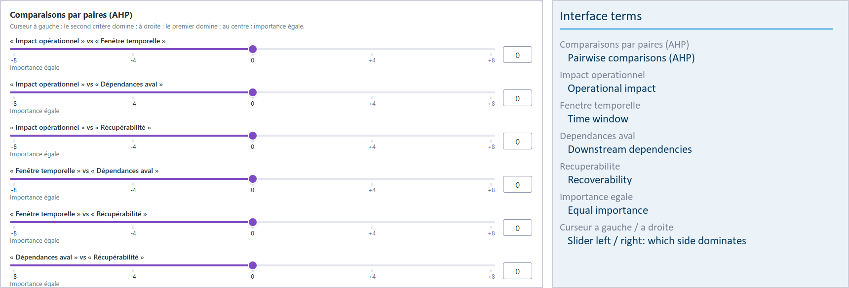
DECLARED URGENCY
1
2
3
4
5
Elicited from the operator, gated on consistency, then propagated downstream
14
THE CONSISTENCY GATE
A weight vector whose consistency ratio exceeds the threshold is refused . The operator is sent back to the most contradictory of their own comparisons.
Without it, an incoherent judgment would propagate as though it were a considered one.
The application is operated by a French research programme, so its interface is French. The report carries an English key for every term on screen.
FOUR CRITERIA, EACH WITH A COMPUTED COUNTERPART
Pairwise comparisons, not a free-text estimate
Operational impact
Time window
Saaty scale · consistency ratio below 0.10
Downstream dependencies
Recoverability
Four criteria and not more: pairwise comparison degrades past about seven. The six computed blocks are weighted by Fuzzy BWM instead, which needs nine comparisons where AHP would need fifteen.
Notes:
Declared urgency is an estimations but we have tried to get the most out of it. We use multiple methods to calibrate the tools for the 4 criteria conterpart.
Then we used Analytic Hyerachy Process method each week to have a new human data entry, where we ask the customer to fill a short form.
AHP allow us to check the consitency in the human declaration, so we can know if it is realiable or not. Otherwise we politely asked to review.

Slide 15
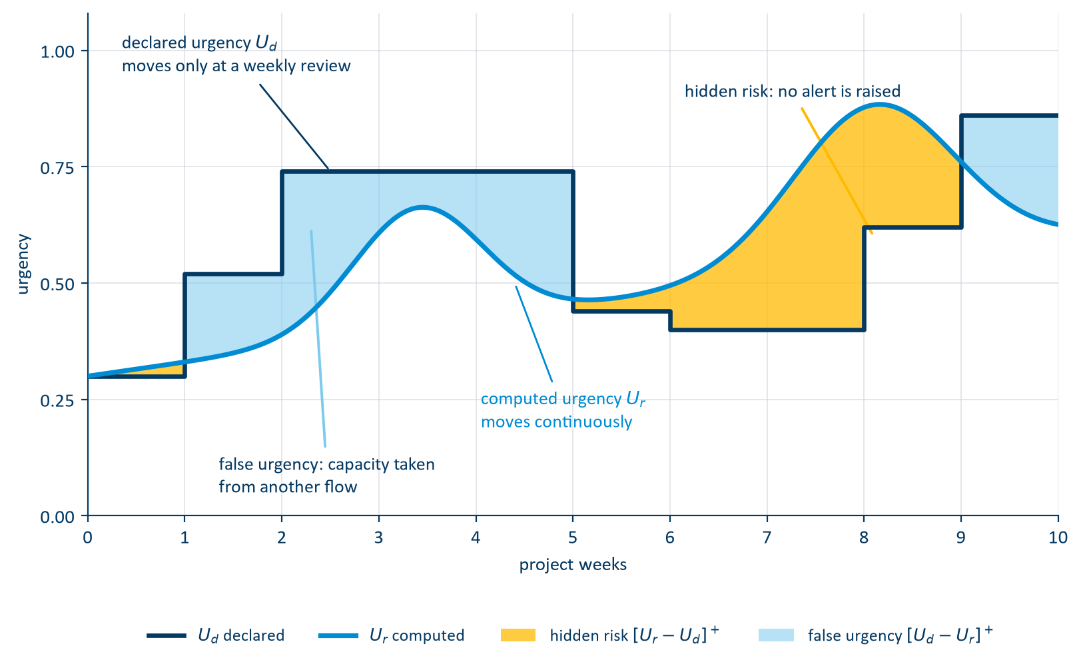
THE ADEQUACY
1
2
3
4
5
Elicited separately, propagated in opposite directions
15
PROPAGATION ACROSS THE NETWORK
γ
Customer · final assembly
Tier 1 · systems
Tier 2 · subassemblies
Tier 3 · raw material
β
γ carries the declaration down to suppliers: demand pressure is what a customer transmits
β carries computed risk up to the customer: physical risk is what a supplier transmits
Same propagation law both ways. Only the direction and the coefficient differ.
Notes:
When we have both signals over the life of one task, we can manage to plot them, and see the mismatch.
The declaration is a staircase llok as it chnage only at each time a human give its signal.
Where the declaration is above the state, the operator is spending attention on a node that does not need it. Capacity taken from another flow. Its False Urgency
Where the state is above the declaration, nobody has raised an alert
That is hidden risk, and it what we are mostly looking for.
Also this signals propagate troughout the supply chain, in opposite directions. Gamma attenuates the declaration as it descends, beta amplifies computed risk as it ascends.
The asymmetry is physical: demand pressure is what a customer transmits, physical risk what a supplier transmits.

Slide 16
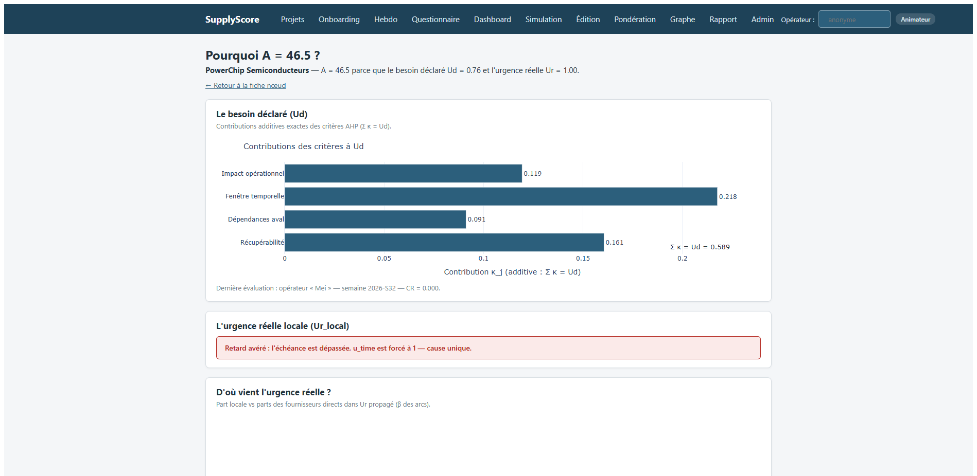
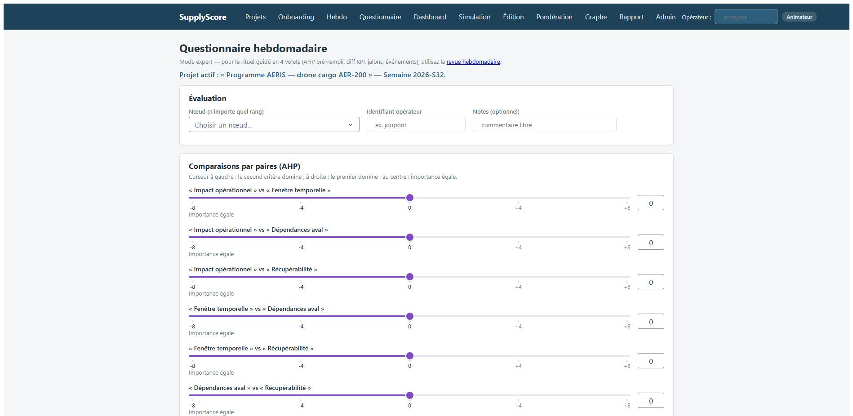
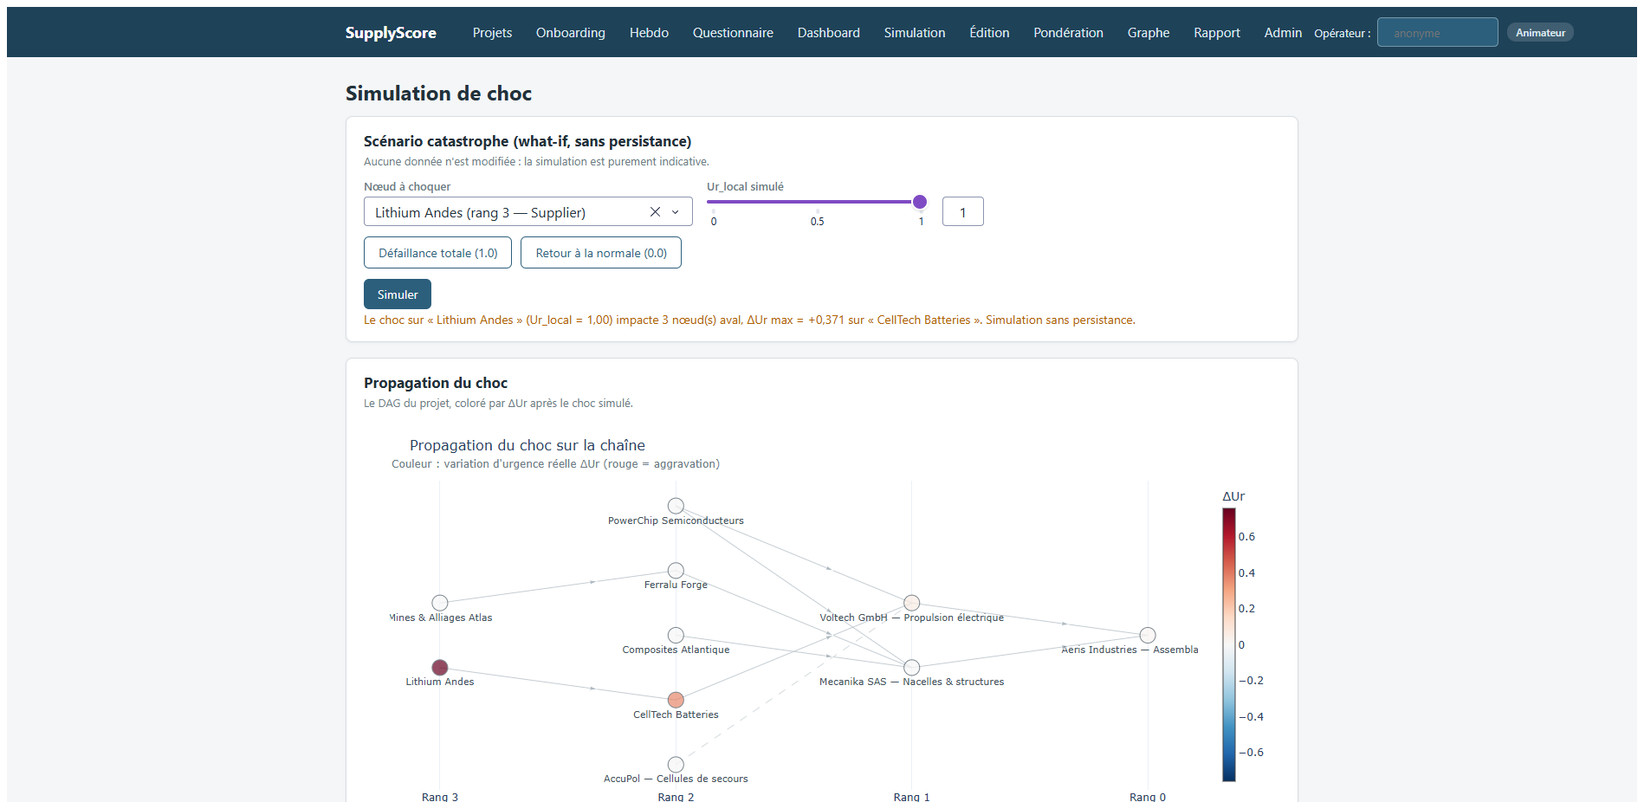
SUPPLYSCORE: THE APPLICATION
1
2
3
4
5
Eleven pages. This is where the declaration is collected and the score is read.
16
THE WEEKLY DECLARATION
Six pairwise comparisons, refused if incoherent.
WHY A = 46.5? The page that rebuilds any score term by term
Declared need on top, computed urgency below, and the single cause when there is one. This page is what made the central diagnosis possible from the application rather than by hand.
The interface is French because the programme that operates it is.
THE ELEVEN PAGES
Projects · Onboarding · Weekly review · Questionnaire · Dashboard · Simulation · Editor · Weighting · Graph · Report · Admin, plus a sheet and an explanation page for every node.
SHOCK SIMULATION
Knock a node out, watch the risk climb to the customer.

Slide 17
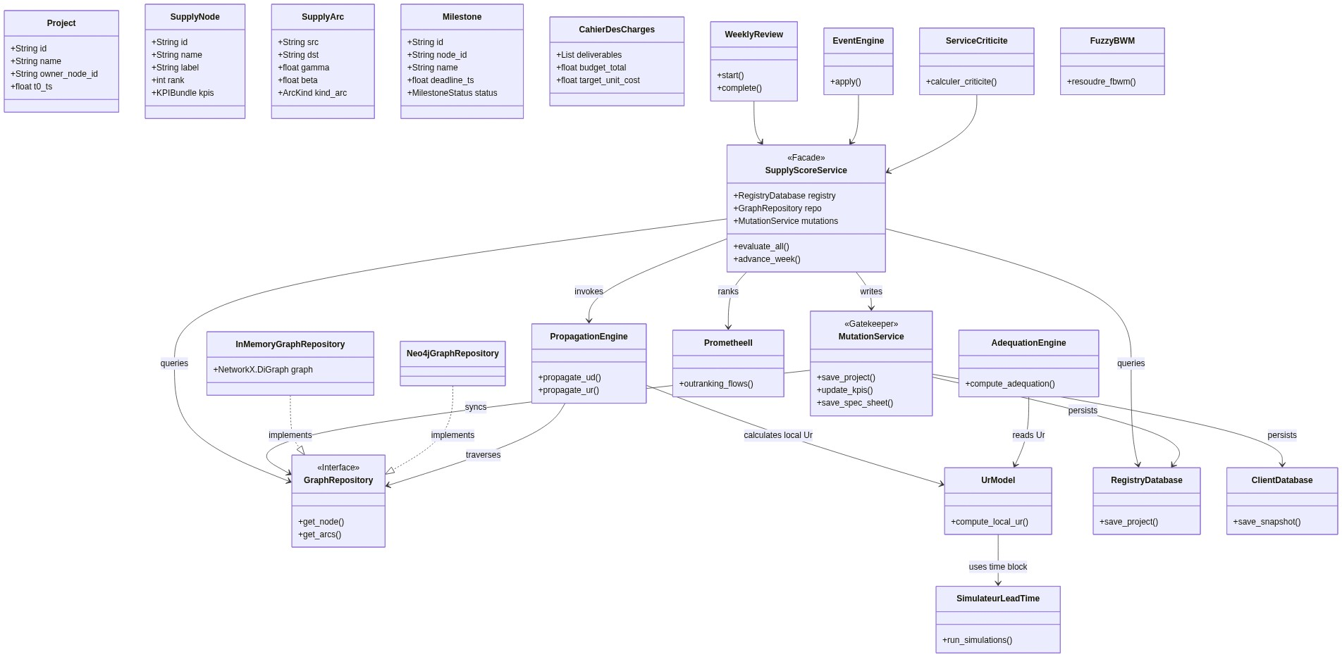
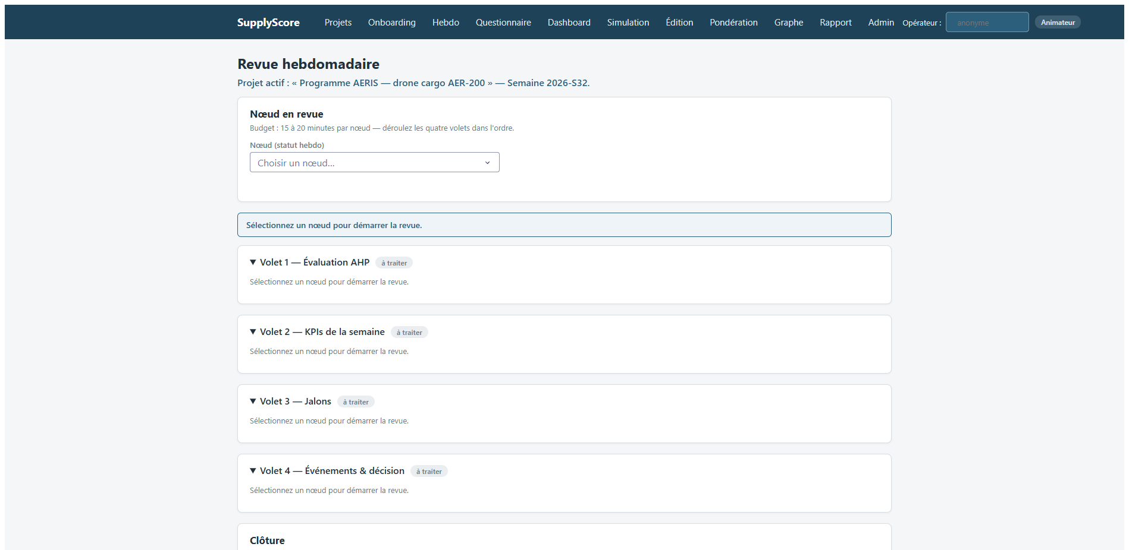
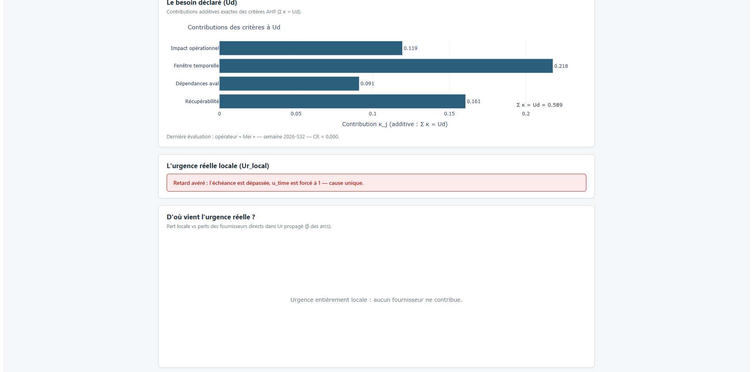
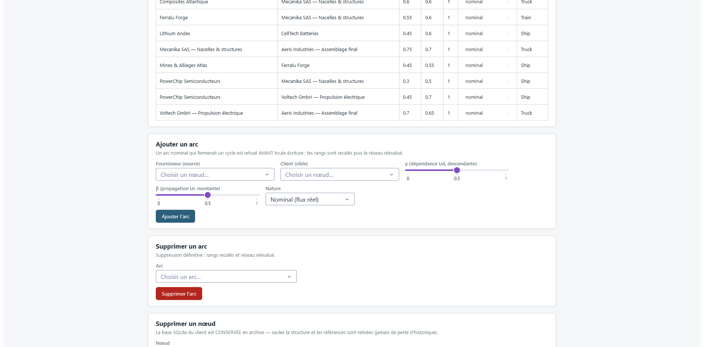
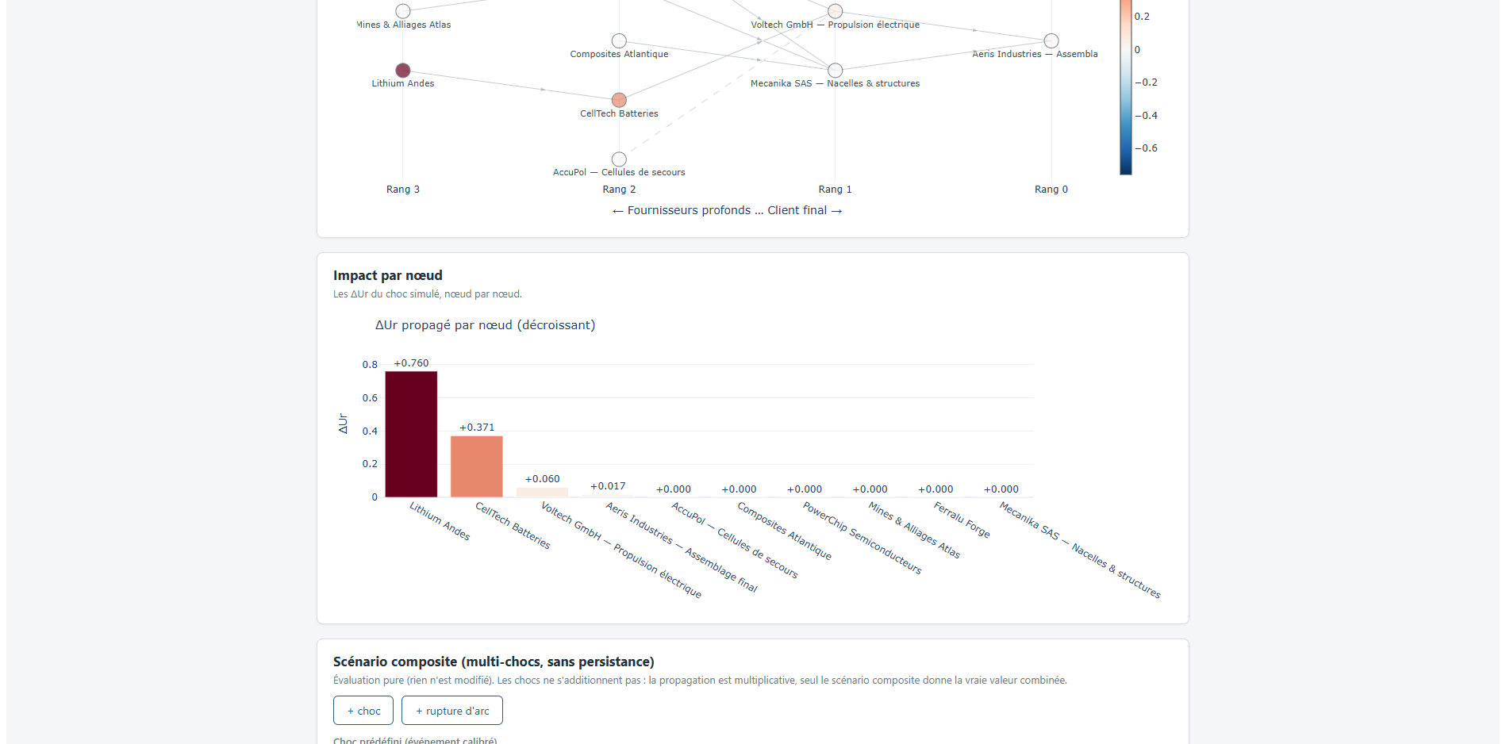
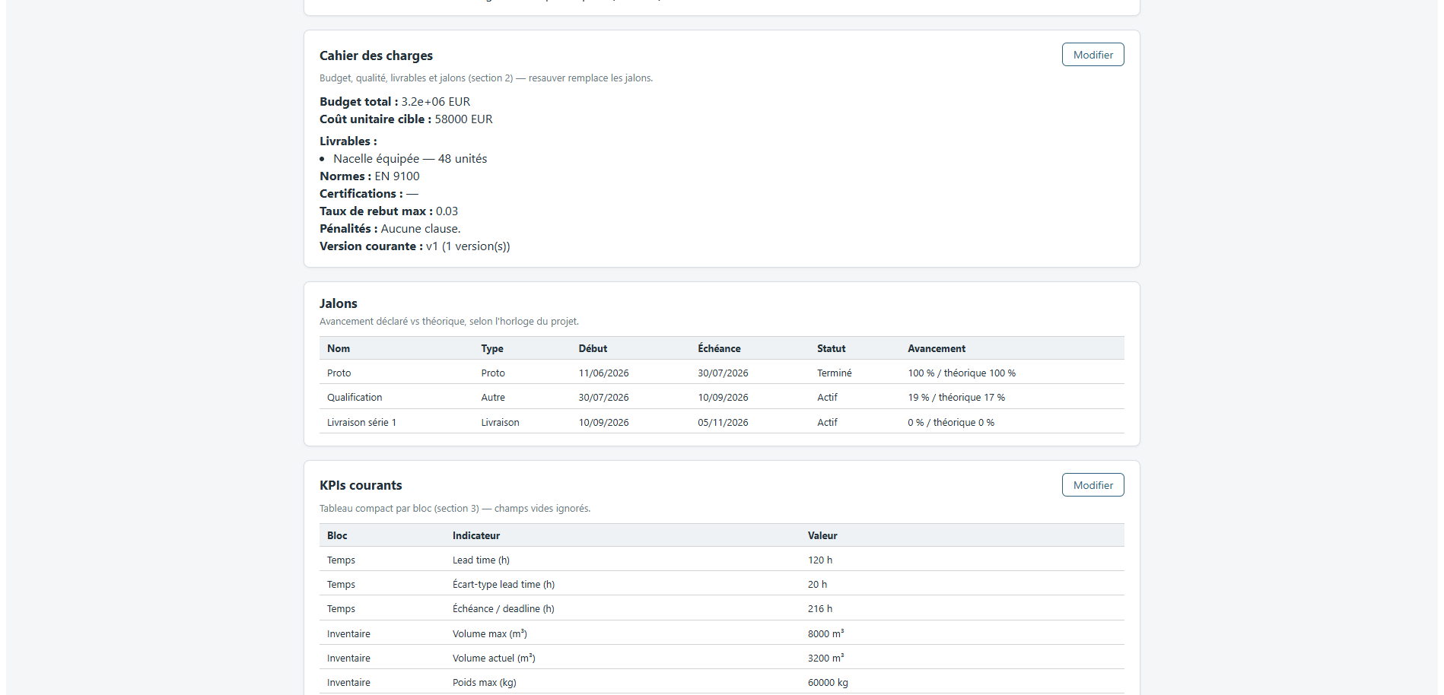
SUPPLYSCORE: ARCHITECTURE
1
2
3
4
5
The class model, and why every write can be traced back
17
THE CLASS MODEL
EVERY PAGE THE OPERATOR REACHES
Weekly review · one signed transaction
Explainability · term by term
Network · generated per project
Criticality · each node knocked out
A NODE, AND WHAT IT CARRIES
Facade the only entry point
Mutation service the audit trail is architectural
One DB per node isolation by storage layout
Every arrow into the data crosses the facade, then the mutation service. Two graph repositories sit behind one interface, so the network can be held in memory or in Neo4j without the domain knowing which.
73 modules · 2 044 automated tests · multi-tenant, one database per node
Notes:
You cannot read this diagram from where you are sitting, and you do not need to.
In the UML you can see that Every operation passes through a single orchestrating facade.
Every business write then crosses a single mutation service that validates ranges, diffs against current state, and records the author.
As the tool must be trusted even an audit part has been implmented inside the archtecture to trace evry decision keep logged and frozen
Also data persistence was a major aspect so we have made that each node have their own DB, to keep isolation.
On the right, the application as the operator meets it. A web interface, where he can manage and see whats happening uder the hood
The weekly review commits as one signed transaction. The explainability page reconstructs any score term by term
That explainability page is what made the next diagnosis possible from the application rather than by hand

Slide 18
PLAN
1
CONTEXT, PROBLEM, MISSION
2
HOW THE PROJECT WAS RUN
3
LITERATURE, DESIGN AND REALISATION
4
RESULTS AND VALIDATION
5
ASSESSMENT AND PERSPECTIVES
18
Notes:
This prez will be in 5 parts !
The first three build the instrument.
The 4 is where the number I just gave you comes from.
The 5 is what I would do next.

Slide 19

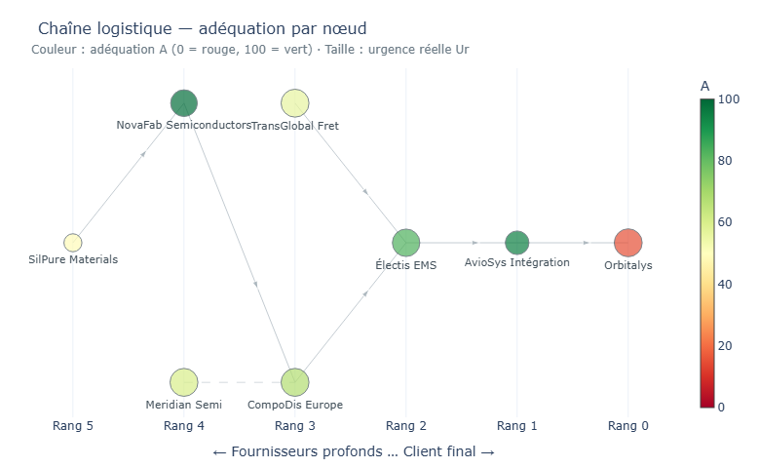
RESULT 1: THE SEMICONDUCTOR SHORTAGE
1
2
3
4
5
8 nodes · 19 weekly turns · nodes ranked by hidden risk above 0.10, against the nodes that later missed
19
1.00
3 / 4
0
8
PRECISION, TURNS 0–5
FUTURE FAILURES FLAGGED
FALSE ALARMS IN SIX TURNS
TURNS OF ADVANCE WARNING
T0 – T5 · signal sharp
T6 – T18 · crisis public, the gap closes
The worst-scoring node is the satellite prime. Flagged from turn 0, it misses at turn 8.
THE DASHBOARD THE COORDINATOR READS
The flag comes from an optimistic declaration against a computed state that is not. That node's own manager was declaring 0.001.
Early warning, not crisis management.
And on a second chain, where declarants judged their own state correctly and simply withheld escalation, the gap selects nothing. It detects misperception, not discretion.
Notes:
Now the results. That iswhere the number i gave you came from.
We managed to replay the 2020 to 2022 semiconductor shortage to test and calibrate the tools.
Real urgency KPIs comes from public time series of the actual crisis, declared urgency from the LLM
What we have leraned is that the tool is able to give an early warning and detect clearly where its mismanged and where thers a mismatch
Where some AI manager was proudly saying that thers no shortage incoming, it was setting it up, but the tool manage to detect it.
But, as i thought, when the shortage is becoming from exogenous part the sgnal crumbles as weeks pass….
Even so this precision is an encouraging observation,

Slide 20
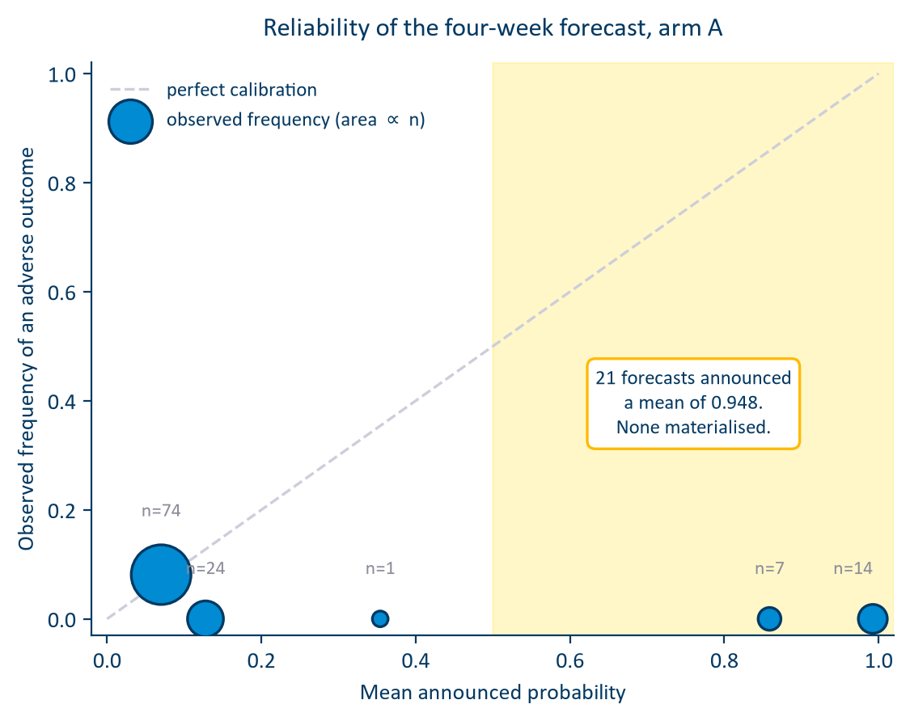
RESULT 2: CAN IT FORECAST A CRISIS?
1
2
3
4
5
Scored against recorded outcomes, diagnosed, repaired, re-measured on the same frozen forecasts
20
BRIER SKILL, BEFORE → AFTER
HORIZON
before
structure
+ uncert.
1 week
−1.278
−0.646
−0.687
2 weeks
−0.690
−0.401
−0.367
3 weeks
−0.654
−0.360
−0.286
4 weeks
−0.553
−0.272
−0.216
The calibration deficit roughly halved at every horizon. AUC movement is not interpretable at this sample size : with twenty-six positives the four-week interval runs from 0.21 to 0.87.
THE HONEST READING
A one-line calendar ratio, with no simulation and no fitted parameter, outranks 500 Monte-Carlo trajectories at six horizons of eight.
The layer buys calibration, not short-horizon discrimination. That is a defensible thing to be, and it is not what the interface promises.
Notes:
I try to get more of that signal and try to forcast the possiblity of the urgency using Monte Carlo simulatiton based on previous historic data of the crisis and compare them with the baseline of earlier.
In a short answer i did not managed to make it work… as it need way more calibration and validation. The result i got was near absolut chance, my Brier skill was even worse that the baseline itself… So bad forcast…. I wont became a good metorologist.
The reliability diagram localises it. Where the model announces a low probability, it is right.
Where it announces a high probability, it is wrong every time…
As we speak i am still working on tuning this method as i am maybe in piste to find out where the missing informations are hidden…
Also i am filling the missing infomations gap with syntethic meaning data as it is hard to find higly public data.

Slide 21
PLAN
1
CONTEXT, PROBLEM, MISSION
2
HOW THE PROJECT WAS RUN
3
LITERATURE, DESIGN AND REALISATION
4
RESULTS AND VALIDATION
5
ASSESSMENT AND PERSPECTIVES
21
Notes:
This prez will be in 5 parts !
The first three build the instrument.
The 4 is where the number I just gave you comes from.
The 5 is what I would do next.

Slide 22


OBJECTIVES VS. OUTCOMES
1
2
3
4
5
2 campaigns · 2 chains · 23 nodes · 33 milestones · 510 declarations
22
O1
Met
Six blocks, bidirectional propagation, asymmetric score: every term decomposable
O2
Met
SupplyScore delivered: multi-tenant, every write audited, tested, documented
O3
Met
Propagation and criticality operational; the saturation collapse found and repaired
O4
Met, domain established
Right at node level on chain 1; scored, located, repaired, re-measured; then bounded by chain 2 and the baseline
O5
Met, ongoing
Segmentation model still running, with usable early results
SupplyScore is the tool. DISCO is the DIN's serious game. Smart & Green Supply Chain is the programme.
WHAT THE PROGRAMME CAN NOW SAY ABOUT THE INSTRUMENT
Detects misperception
An early-warning instrument that closes once a crisis is public
Its forecast buys calibration , not short-horizon discrimination
Notes:
Everything you have seen rests on this: 2 campaigns, 2 chains, 23 nodes, 33 milestones, 510 déclarations
objectives met What the programme can now say about SupplyScore comes down to three statements."
"It detects misperception."
"It is an early-warning."
"And its forecast layer buys calibration rather than short-horizon discrimination."

Slide 23


LIMITS AND WHAT COMES NEXT
1
2
3
4
5
Two limits of sample, two of method, and a list produced by measurement
23
LIMITS
FOR ALTEN, IN ORDER
WHAT NO EXTRA RUN WOULD SETTLE
Agents declared, not human consultants
1
Connect computed urgency to the forecast quantity.
Two scenarios written by one hand cannot separate a property of
supply chains from a property of their author.
Only an instrumented live chain reaches that.
Seven positives across two chains
The campaign ran at 25.6% indicator coverage, three blocks of six inert
2
Collect more indicators before calibrating
ESTIA COMPETENCY FRAMEWORK
Blocks are assumed independent, and two were perfectly correlated on one run
3
Make the forecast state its own ignorance; smooth the alarm
CI1
CI3
CI5
CE3
CE4
CE5
CST1
CST2
CST7
4
Run the campaign with humans, the only run that decides
WHAT STAYS AT ALTEN
SupplyScore
Two frozen scenarios
The diagnostic method
A registered protocol
73 modules, 2044 tests, documented, handed over running
and the full declaration record of every campaign
how the blind block was found, and the repair scored
for the human campaign, ready to run

Slide 24
WHAT I TAKE FROM IT
1
2
3
4
5
Three lessons, and the direction they point
24
1
2
3
THE SYSTEM KEPT MEASURING ITSELF
THE NEGATIVE RESULTS WERE THE USEFUL ONES
STATE THE RESULT THAT DOES NOT FLATTER THE WORK
Three times the two signals were not independent: the dry run anchored the declaration on the computed value, the agents reproduced their own briefing, and arm B closed the loop on purpose. Each time the symptom looked like a modelling problem and the cause was circularity. I would now design the independence of the two signals before designing either of them.
The forecast is badly calibrated, the confident tail is entirely false, and one block was structurally blind. None of that would have been found by a project optimising for a positive result, and each of them points at a named repair. A confident self-report is not evidence, including my own.
This project measures the gap between what people declare and what is actually true. Measuring that gap in a supply chain while reproducing it in my own reporting would have been the worst available outcome.
AND THE DIRECTION IT POINTS
I want to work where a model meets the person who has to act on it. That boundary is where the interesting failures live: not in the mathematics, which can be checked, but in what a number does to the judgement of the person reading it.
WHAT THE ESTIA FRAMEWORK CALLS IT
CI1
CI5
CE3
CE5
CST1
CST2
CST7
Systemic analysis · complex problem solving · project control · information qualified and diffused · engineering strategy · modelling and simulation · tools for R&D

Slide 25


THANK YOU
QUESTIONS
HOARAU John · Promotion 2026 ALTEN Sud-Ouest · Innovation Division · Toulouse Lab 13 April to 16 October 2026
25

